Slide 1
Abstract
Resonant Faraday rotation on alkali metals can be used to monitor the polarization of dense spin-polarized helium-3 targets. If spin exchange optical pumping is used to polarize the helium-3 nuclei, sparse amounts of Rb and K will be present in the target. Tuning external-cavity diode lasers to the D2 transitions of Rb or K maximizes the rotation of linearly polarized light due to the Faraday effect; which allowed measurement of small magnetic fields produced by the spin-polarized nuclei. To accomplish this goal, the laser frequencies must remain stable over long periods of time due to various environmental changes. We performed diagnostic interferometry to determine the rate of frequency drift and to locate the D2 transition frequencies via custom methods of automation on data acquisition and laser parameter control. Then, using the doppler free absorption spectrum of Rb or K as a feedback mechanism, a lock-in technique was used to generate an error signal and a PID feedback system allowed us to minimize the frequency drift of our ECDL to provide sufficient laser frequency stability for the Faraday rotation experiment.

Slide 2
Laser Frequency Stabilization Project at the University of Kentucky REU Program

Slide 3
Motivation
Insert Picture of Korsch’s Faraday Rotation Experiment?
Rb and K have strong D2 Transitions at around 780nm and 770 nm. Laser light tuned to those wavelengths will stimulated those transitions and allow accurate measurement of the contamination of those alkali metals in our target

Slide 4
Project Description
Tunable External Cavity Diode Lasers (ECDLs) are used.
ECDLs experience frequency drift
The goal of the project is to minimize the amount of frequency drift over long periods of time to maintain the maximum light polarization rotation due to the Faraday effect.

Slide 5

Quantifying $ν$-Drift
Shining light through a scanning Fabry Perot Interferometer, and evaluating the timing of the throughput flashes gave us a measure of the instantaneous drift velocity.

Slide 6
Locking Method
Side of Fringe Locking
Used to lock to the side of any filter

Slide 7
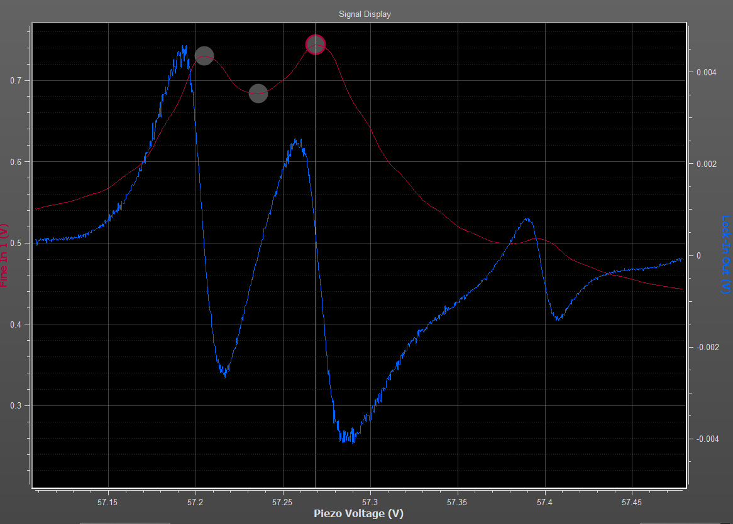
Top of Fringe Locking
Though the method involves more complicated data analysis in
order to extract an error
function free from coupling to
laser intensity.
Can only be used to lock to a
narrowband filter.

Slide 8
Quantifying $ν$-Drift
Shining light through a scanning Fabry Perot Interferometer, and evaluating the timing of the throughput flashes gave us a measure of the instantaneous drift velocity.

